Slide 1



Home Worth: Predicting Real Estate Values
This project delves into the domain of real estate analytics, focusing on the prediction of house prices. By leveraging data science and machine learning, we aim to develop a model that accurately forecasts property values, empowering stakeholders with valuable insights for informed decision-making.

Slide 2

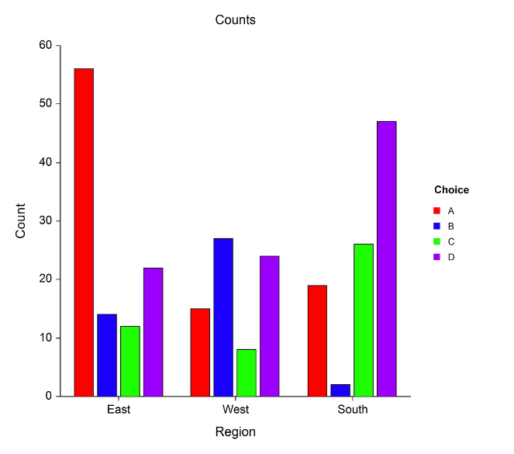
Data Science and Machine Learning
1
Data-Driven Approach
The project utilizes data-driven techniques to analyze historical property data and identify patterns that influence house prices.
2
Machine Learning Algorithms
Machine learning algorithms are employed to learn from the data and build a predictive model that can forecast future property values.
3
Supervised Learning
The project focuses on supervised learning, specifically regression models, to predict continuous numerical outcomes, such as house prices.
4
Regression Models
Regression models are used to establish relationships between property features and their corresponding prices, enabling accurate price predictions.

Slide 3


Problem Statement
Objective
The primary objective is to develop a regression model that predicts house prices using key features such as square footage, the number of bedrooms and bathrooms, and the age of the property.
Key Question
Can machine learning models be utilized to accurately predict house prices, thereby enabling more strategic decision-making in the real estate market?
Answer
Yes, machine learning models can effectively predict house prices by analyzing various property features. These models help stakeholders determine the fair market value of properties, forecast future price trends, and make informed real estate decisions.

Slide 4
Retained Variables
Square Footage
Number of Bedrooms
Number of Bathrooms
Age of the Property
A direct indicator of property size, which is a major determinant of market value.
Reflects the capacity of the property, making it a critical factor in price determination.
Similar to bedrooms, the number of bathrooms influences buyer interest and valuation.
The age affects the condition and maintenance requirements, influencing market value.

Slide 5
Removed Variables
Address
Owner Name
Zip Code
While important for location, the address itself does not directly predict price and can add unnecessary complexity.
This has no bearing on market value and is irrelevant to price prediction.
Though location is key, broader neighborhood classifications in the model are assumed to cover location-related price differences.

Slide 6

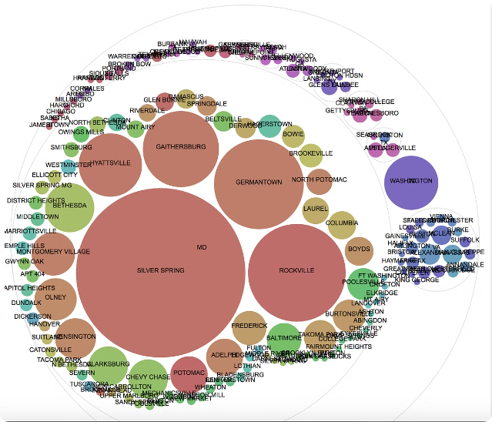
Best Model: Lasso Regression
Metric
Lasso Regression
R² Score
High
Root Mean Square Error (RMSE)
Low

Slide 7


Modeling Process
1
Data Preprocessing
The dataset was cleaned to address missing values and outliers. Key variables were selected based on their relevance to house prices.
2
Model Training and Testing
The dataset was split into training and testing sets, and various regression models were trained on the training data: Linear Regression, Ridge Regression, and Lasso Regression.
3
Model Evaluation
The models were evaluated using R² and RMSE. Among these, Lasso Regression outperformed the others, offering a good balance of predictive accuracy and simplicity.

Slide 8



Output and Advantages
1
Positive Outcome
The model provides accurate and reliable predictions, empowering stakeholders to make informed decisions regarding property transactions.
2
Early Market Insight
The model delivers early indicators of market trends, supporting proactive investment and selling decisions.
3
Support for Real Estate Professionals
Real estate agents can leverage the model’s predictions to enhance their market analysis and client advisories.
4
Cost Efficiency
Accurate price predictions help avoid overpaying or undervaluing properties, reducing potential financial losses.

Slide 9




Special Notes for Presentation
Emphasize Lasso Regression
Mention Other Models
In the presentation, especially in PowerPoint slides, focus on Lasso Regression as the best-performing model. Explain its advantages and why it was chosen over others.
Briefly mention the other regression models (Linear Regression, Ridge Regression) to demonstrate that various approaches were considered and compared. Emphasize that Lasso Regression was superior for this dataset.

Slide 10


Conclusion
The HomeWorth project successfully demonstrates the potential of machine learning in real estate analytics. By leveraging Lasso Regression, we have developed a model that accurately predicts house prices, providing valuable insights for homeowners, real estate agents, and potential buyers. This model empowers stakeholders to make informed decisions, optimize resources, and navigate the real estate market with greater confidence.

